Slide 1


Optimized Equipment Utilization and Management for IVF Laboratory Operations
Domain : Healthcare Operations Analytics
Tools Used : Python, SQL, Power BI
Focus : Equipment efficiency, downtime reduction operational Insights.
Prepared by :
Badam Siva Rami Reddy

Slide 2
Contents
Business Problem
Project Overview and Scope
Project Architecture - Data Flow Diagram
Data Dictionary
Exploratory Data Analysis
Statistical and Business Insights(EDA)
Data Preprocessing
Data Visualization
Notes:
Change

Slide 3
Business Problem
--> High Cost Equipment in IVF Labs like incubators, microscopes, ICSI workstations.
--> Utilization varies widely 40 to 80%.
--> Its idle time is 20-30% & 10-15% workflow delays.
--> 15-25% unnecessary operating costs.
--> Lack of redundancy causes 2-4 hours delays, affecting embryo viability and throughput.

Slide 4
Project Overview and Scope
---> Client : One of the leading IVF clinics in India.
IVF laboratories rely on expensive and critical equipment.
Efficient utilization is essential to reduce cost and delays.
• EDA of utilization, idle hours, delays, capacity.
Development of KPIs such as utilization, total downtime, total runtime.
This project analyses equipment usage and operational performance.
Goal is to support data-driven operational decisions.

Slide 5
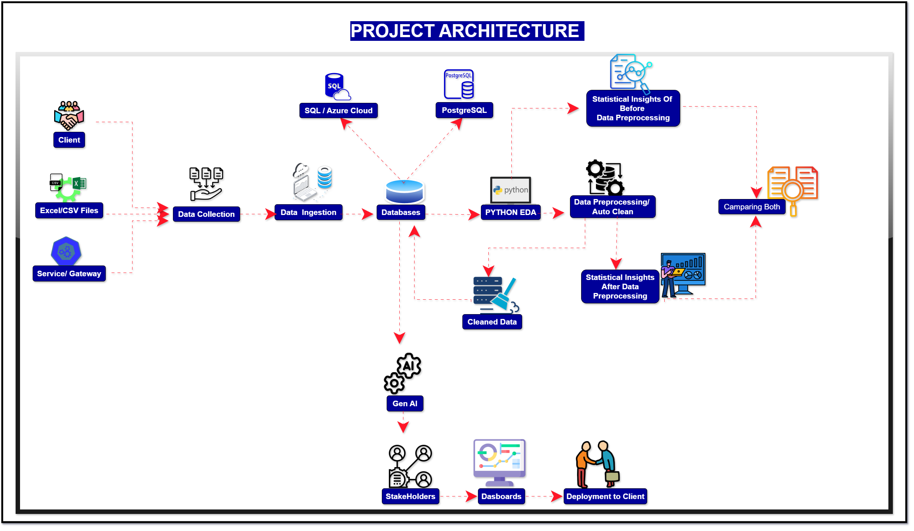
Project Architecture – Data Flow Diagram

Slide 6
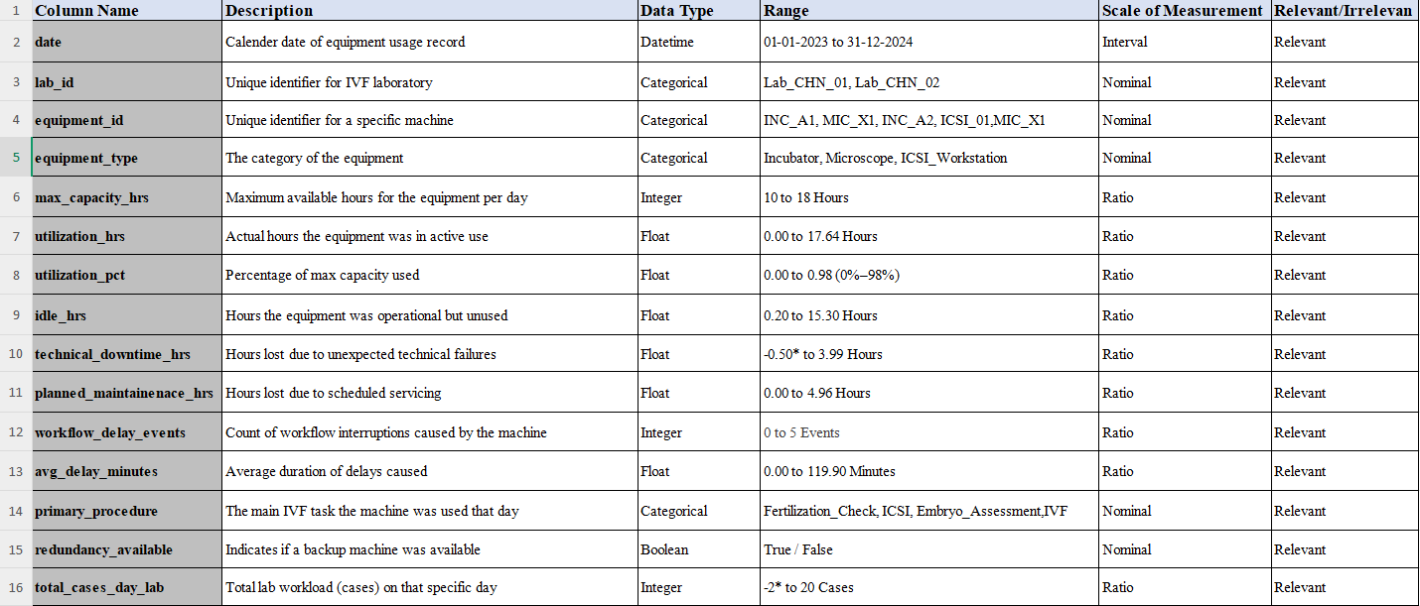
Data Dictionary

Slide 7
Exploratory Data Analysis(EDA)
Analyzed distribution and central tendency of equipment capacity, utilization, and idle hours.
Identified moderate utilization (~61%) across IVF equipment, indicating underuse of available capacity.
Observed consistent idle hours (~39%), highlighting inefficiencies in daily scheduling.
Capacity hours show negative skewness, confirming unused operational potential.
Utilization patterns are stable with low variability, suggesting predictable demand.
No recorded technical downtime or maintenance events, indicating possible data gaps or limited tracking.
Case volume remains steady across weekdays, with reduced activity during weekends.
Overall trends suggest opportunities to improve throughput without additional equipment investment.

Slide 8
Exploratory Data Analysis [EDA]
Statistical Insights
Business Insights
Average max capacity is ~16 hours, with a negative skew indicating unused potential capacity
Utilization percentage averages ~61%, showing moderate but not optimal equipment usage
Idle hours (~39%) are consistently present, indicating inefficiency in scheduling
Utilization and idle hours show low kurtosis, suggesting stable but suboptimal performance patterns
Technical downtime, maintenance hours, and workflow delays are zero, indicating no recorded disruptions
Daily case volume is moderate with limited variability across days
Equipment usage is evenly distributed across weekdays, with lower activity on weekends.
Significant underutilization of high-cost IVF equipment, leading to operational inefficiency
Excess idle hours indicate opportunity to optimize scheduling and workload distribution
Absence of recorded downtime may indicate data gaps or lack of downtime tracking
Stable utilization patterns suggest potential to increase throughput without additional investment
Weekend underutilization presents an opportunity for planned maintenance or extended scheduling
Management can improve ROI by aligning capacity with actual demand using data-driven planning
Notes:
EDA is used for seeing what the data can tell us before the modeling task.
Change

Slide 9
Data Preprocessing
Reviewed dataset structure and understood business meaning of all columns.
Corrected data types for date, numerical, and categorical fields.
Handled missing values using statistical methods and business logic.
Removed duplicate and inconsistent records.
Standardized text fields and naming conventions.
Detected and treated outliers in utilization and downtime metrics.
Created derived features such as utilization percentage and idle hours.
Validated data consistency (capacity limits, logical ranges).
Prepared final clean dataset for EDA and Power BI visualization.
Notes:
Keep observations

Slide 10
Data Visualization
Designed an interactive Power BI dashboard to monitor equipment performance.
Used KPI cards to display utilization %, idle hours, and downtime.
Created bar charts to compare utilization across equipment types.
Used line charts to analyze daily and monthly utilization trends.
Implemented lab-wise and equipment-wise filters for drill-down analysis.
Visualized downtime and maintenance impact on utilization.
Enabled quick identification of underutilized and overutilized equipment.
Provided clear visuals to support operational and management decisions.
Notes:
Add graphical

Slide 11
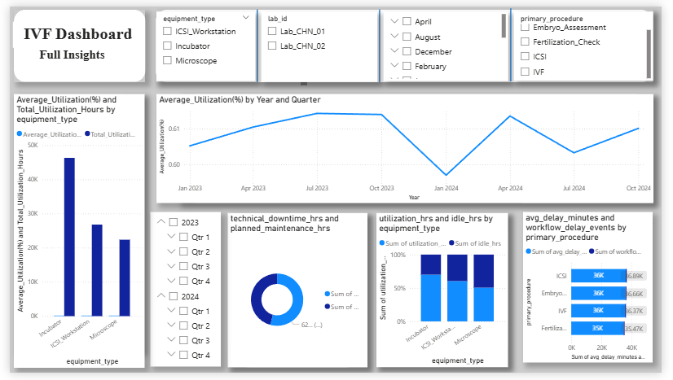
Data Visualization Using Power BI

Slide 12
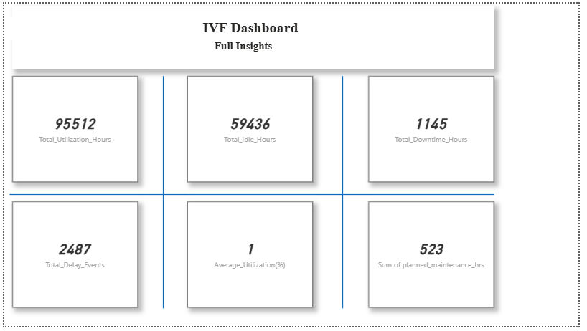
Data Visualization Using Power BI(KPI Cards)

Slide 13


